Slide 1
Search applications
David Kauchak
CS30 – Spring 2015

Slide 2
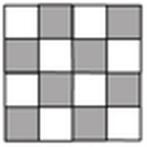
N-queens problem
Place N queens on an N by N chess board such that none of the N queens are attacking any other queen.

Slide 3
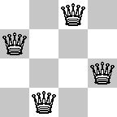
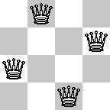
N-queens problem
Place N queens on an N by N chess board such that none of the N queens are attacking any other queen.

Slide 4
N-queens problem
Place N queens on an N by N chess board such that none of the N queens are attacking any other queen.

Slide 5
N-queens problem
Place N queens on an N by N chess board such that none of the N queens are attacking any other queen.
How do we solve this with search:
What is a state?
What is the start state?
What is the goal?
How do we transition from one state to the next?

Slide 6
Search algorithm
add the start state to to_visit
Repeat
take a state off the to_visit list
if it’s the goal state
we’re done!
if it’s not the goal state
Add all of the successive states to the to_visit list
Is this a goal state?
What states can I get to from the current state?
Any problem that we can define these two things can be plugged into the search algorithm!

Slide 7
N queens problem
http://en.wikipedia.org/wiki/Eight_queens_puzzle

Slide 8
Missionaries and Cannibals
Three missionaries and three cannibals wish to cross the river. They have a small boat that will carry up to two people. Everyone can navigate the boat. If at any time the Cannibals outnumber the Missionaries on either bank of the river, they will eat the Missionaries. Find the smallest number of crossings that will allow everyone to cross the river safely.
What is the “state” of this problem (it should capture all possible valid configurations)?

