Slide 1
Perceptron Learning
David Kauchak CS 451 – Fall 2013

Slide 2
Admin
Assignment 1 solution available online
Assignment 2 Due Sunday at midnight
Assignment 2 competition site setup later today

Slide 3
Machine learning models
Some machine learning approaches make strong assumptions about the data
If the assumptions are true this can often lead to better performance
If the assumptions aren’t true, they can fail miserably
Other approaches don’t make many assumptions about the data
This can allow us to learn from more varied data
But, they are more prone to overfitting
and generally require more training data

Slide 4
What is the data generating distribution?

Slide 5
What is the data generating distribution?

Slide 6
What is the data generating distribution?

Slide 7
What is the data generating distribution?

Slide 8
What is the data generating distribution?

Slide 9
What is the data generating distribution?

Slide 10
Actual model

Slide 11
Model assumptions
If you don’t have strong assumptions about the model, it can take you a longer to learn
Assume now that our model of the blue class is two circles

Slide 12
What is the data generating distribution?

Slide 13
What is the data generating distribution?

Slide 14
What is the data generating distribution?

Slide 15
What is the data generating distribution?

Slide 16
What is the data generating distribution?

Slide 17
Actual model

Slide 18
What is the data generating distribution?
Knowing the model beforehand can drastically improve the learning and the number of examples required

Slide 19
What is the data generating distribution?

Slide 20
Make sure your assumption is correct, though!

Slide 21
Machine learning models
What were the model assumptions (if any) that k-NN and decision trees make about the data?
Are there data sets that could never be learned correctly by either?

Slide 22
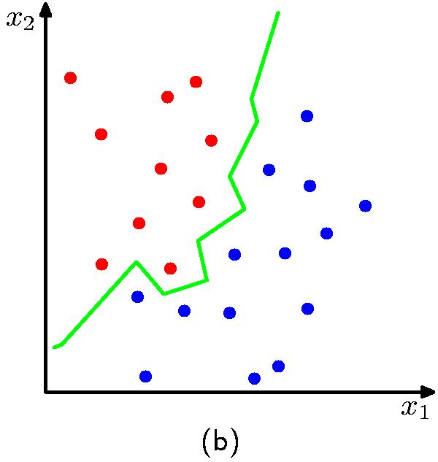
k-NN model
K = 1
Notes:
NO model assumptions
does assume that proximity in the feature space relates to class
kNN can learn any arbitrary separation between the classes

Slide 23
Decision tree model
label 1
label 2
label 3
Axis-aligned splits/cuts of the data
Notes:
Assumes the data is separable by axis-aligned splits
Fairly week assumption
many things it can’t learn perfectly

Slide 24
Bias
The “bias” of a model is how strong the model assumptions are.
low-bias classifiers make minimal assumptions about the data (k-NN and DT are generally considered low bias
high-bias classifiers make strong assumptions about the data

Slide 25
Linear models
A strong high-bias assumption is linear separability:
in 2 dimensions, can separate classes by a line
in higher dimensions, need hyperplanes
A linear model is a model that assumes the data is linearly separable

Slide 26
Hyperplanes
A hyperplane is line/plane in a high dimensional space
What defines a line?
What defines a hyperplane?

Slide 27
Defining a line
Any pair of values (w₁,w₂) defines a line through the origin:
f₂
f₁

Slide 28
Defining a line
Any pair of values (w₁,w₂) defines a line through the origin:
f₂
-2
-1
0
1
2
1
0.5
0
-0.5
-1
f₁

Slide 29
Defining a line
Any pair of values (w₁,w₂) defines a line through the origin:
f₂
-2
-1
0
1
2
1
0.5
0
-0.5
-1
f₁

Slide 30
Defining a line
Any pair of values (w₁,w₂) defines a line through the origin:
f₂
(1,2)
w=(1,2)
f₁
We can also view it as the line perpendicular to the weight vector

Slide 31
Classifying with a line
Mathematically, how can we classify points based on a line?
f₂
BLUE
(1,1)
f₁
RED
(1,-1)
w=(1,2)

Slide 32
Classifying with a line
Mathematically, how can we classify points based on a line?
f₂
BLUE
(1,1):
(1,1)
(1,-1):
f₁
RED
(1,-1)
w=(1,2)
The sign indicates which side of the line

Slide 33
Defining a line
Any pair of values (w₁,w₂) defines a line through the origin:
f₂
f₁
How do we move the line off of the origin?

Slide 34
Defining a line
Any pair of values (w₁,w₂) defines a line through the origin:
f₂
-2
-1
0
1
2
f₁

Slide 35
Defining a line
Any pair of values (w₁,w₂) defines a line through the origin:
f₂
Now intersects at -1
-2
-1
0
1
2
0.5
0
-0.5
-1
-1.5
f₁

Slide 36
Linear models
A linear model in n-dimensional space (i.e. n features) is define by n+1 weights:
In two dimensions, a line:
In three dimensions, a plane:
In n-dimensions, a hyperplane
(where b = -a)

Slide 37
Classifying with a linear model
We can classify with a linear model by checking the sign:
Positive example
f₁, f₂, …, f_{n}
classifier
Negative example

Slide 38
Learning a linear model
Geometrically, we know what a linear model represents
Given a linear model (i.e. a set of weights and b) we can classify examples
learn
Training
Data
How do we learn a linear model?
(data with labels)

Slide 39
Positive or negative?
NEGATIVE

Slide 40
Positive or negative?
NEGATIVE

Slide 41
Positive or negative?
POSITIVE

Slide 42
Positive or negative?
NEGATIVE

Slide 43
Positive or negative?
POSITIVE

Slide 44
Positive or negative?
POSITIVE

Slide 45
Positive or negative?
NEGATIVE

Slide 46
Positive or negative?
POSITIVE

Slide 47
A method to the madness
blue = positive
yellow triangles = positive
all others negative
How is this learning setup different than the learning we’ve done before?
When might this arise?

Slide 48
Online learning algorithm
0
learn
Labeled data
Only get to see one example at a time!

Slide 49
Online learning algorithm
0
0
learn
Labeled data
Only get to see one example at a time!

Slide 50
Online learning algorithm
0
0
learn
Labeled data
1
Only get to see one example at a time!

Slide 51
Online learning algorithm
0
0
learn
Labeled data
1
1
Only get to see one example at a time!

Slide 52
Online learning algorithm
0
0
learn
Labeled data
1
1
…
Only get to see one example at a time!

Slide 53
Learning a linear classifier
f₂
f₁
What does this model currently say?
w=(1,0)

Slide 54
Learning a linear classifier
f₂
NEGATIVE
f₁
POSITIVE
w=(1,0)

Slide 55
Learning a linear classifier
f₂
(-1,1)
f₁
Is our current guess:
right or wrong?
w=(1,0)

Slide 56
Learning a linear classifier
f₂
(-1,1)
f₁
predicts negative, wrong
How should we update the model?
w=(1,0)

Slide 57
Learning a linear classifier
f₂
(-1,1)
f₁
Should move this direction
w=(1,0)

Slide 58
A closer look at why we got it wrong
w₁
w₂
(-1, 1, positive)
We’d like this value to be positive since it’s a positive value
Which of these contributed to the mistake?

Slide 59
A closer look at why we got it wrong
w₁
w₂
(-1, 1, positive)
We’d like this value to be positive since it’s a positive value
contributed in the wrong direction
could have contributed (positive feature), but didn’t
How should we change the weights?

Slide 60
A closer look at why we got it wrong
w₁
w₂
(-1, 1, positive)
We’d like this value to be positive since it’s a positive value
contributed in the wrong direction
could have contributed (positive feature), but didn’t
decrease
increase
1 -> 0
0 -> 1

Slide 61
Learning a linear classifier
f₂
(-1,1)
f₁
Graphically, this also makes sense!
w=(0,1)

Slide 62
Learning a linear classifier
f₂
f₁
Is our current guess:
right or wrong?
(1,-1)
w=(0,1)

Slide 63
Learning a linear classifier
f₂
f₁
predicts negative, correct
(1,-1)
How should we update the model?
w=(0,1)

Slide 64
Learning a linear classifier
f₂
f₁
Already correct… don’t change it!
(1,-1)
w=(0,1)

Slide 65
Learning a linear classifier
f₂
f₁
Is our current guess:
right or wrong?
(-1,-1)
w=(0,1)

Slide 66
Learning a linear classifier
f₂
f₁
predicts negative, wrong
(-1,-1)
How should we update the model?
w=(0,1)

Slide 67
Learning a linear classifier
f₂
Should move this direction
f₁
(-1,-1)
w=(0,1)

Slide 68
A closer look at why we got it wrong
w₁
w₂
(-1, -1, positive)
We’d like this value to be positive since it’s a positive value
Which of these contributed to the mistake?

Slide 69
A closer look at why we got it wrong
w₁
w₂
(-1, -1, positive)
We’d like this value to be positive since it’s a positive value
didn’t contribute, but could have
contributed in the wrong direction
How should we change the weights?

Slide 70
A closer look at why we got it wrong
w₁
w₂
(-1, -1, positive)
We’d like this value to be positive since it’s a positive value
didn’t contribute, but could have
contributed in the wrong direction
decrease
decrease
0 -> -1
1 -> 0

Slide 71
Learning a linear classifier
f₂
f₁, f₂, label
-1,-1, positive
-1, 1, positive
1, 1, negative
1,-1, negative
f₁
w=(-1,0)

