Slide 1
Gradient descent
David Kauchak CS 451 – Fall 2013

Slide 2
Admin
Assignment 5

Slide 3
Math background

Slide 4
Linear models
A strong high-bias assumption is linear separability:
in 2 dimensions, can separate classes by a line
in higher dimensions, need hyperplanes
A linear model is a model that assumes the data is linearly separable

Slide 5
Linear models
A linear model in n-dimensional space (i.e. n features) is define by n+1 weights:
In two dimensions, a line:
In three dimensions, a plane:
In m-dimensions, a hyperplane
(where b = -a)

Slide 6
Perceptron learning algorithm
repeat until convergence (or for some # of iterations):
for each training example (f₁, f₂, …, f_{m}, label):
if prediction * label ≤ 0: // they don’t agree
for each w_{j}:
w_{j} = w_{j} + f_{j}*label
b = b + label

Slide 7
Which line will it find?

Slide 8
Which line will it find?
Only guaranteed to find some line that separates the data

Slide 9
Linear models
Perceptron algorithm is one example of a linear classifier
Many, many other algorithms that learn a line (i.e. a setting of a linear combination of weights)
Goals:
Explore a number of linear training algorithms
Understand why these algorithms work

Slide 10
Perceptron learning algorithm
repeat until convergence (or for some # of iterations):
for each training example (f₁, f₂, …, f_{m}, label):
if prediction * label ≤ 0: // they don’t agree
for each w_{i}:
w_{i} = w_{i} + f_{i}*label
b = b + label

Slide 11
A closer look at why we got it wrong
w₁
w₂
(-1, -1, positive)
We’d like this value to be positive since it’s a positive value
didn’t contribute, but could have
contributed in the wrong direction
Intuitively these make sense
Why change by 1?
Any other way of doing it?
decrease
decrease
0 -> -1
1 -> 0

Slide 12
Model-based machine learning
pick a model
e.g. a hyperplane, a decision tree,…
A model is defined by a collection of parameters
What are the parameters for DT? Perceptron?
Notes:
DT: the structure of the tree, which features each node splits on, the predictions at the leaves
perceptron: the weights and the b value

Slide 13
Model-based machine learning
pick a model
e.g. a hyperplane, a decision tree,…
A model is defined by a collection of parameters
pick a criteria to optimize (aka objective function)
What criterion do decision tree learning and perceptron learning optimize?

Slide 14
Model-based machine learning
pick a model
e.g. a hyperplane, a decision tree,…
A model is defined by a collection of parameters
pick a criteria to optimize (aka objective function)
e.g. training error
develop a learning algorithm
the algorithm should try and minimize the criteria
sometimes in a heuristic way (i.e. non-optimally)
sometimes explicitly

Slide 15
Linear models in general
pick a model
pick a criteria to optimize (aka objective function)
These are the parameters we want to learn

Slide 16
Some notation: indicator function
Convenient notation for turning T/F answers into numbers/counts:

Slide 17
Some notation: dot-product
Sometimes it is convenient to use vector notation
We represent an example f₁, f₂, …, f_{m} as a single vector, x
Similarly, we can represent the weight vector w₁, w₂, …, w_{m} as a single vector, w
The dot-product between two vectors a and b is defined as:

Slide 18
Linear models
pick a model
pick a criteria to optimize (aka objective function)
These are the parameters we want to learn
What does this equation say?
Notes:
often you’ll have to be able to tell from context whether the subscript refers to the example or the feature

Slide 19
0/1 loss function
distance from hyperplane
whether or not the prediction and label agree
total number of mistakes, aka 0/1 loss

Slide 20
Model-based machine learning
pick a model
pick a criteria to optimize (aka objective function)
develop a learning algorithm
Find w and b that minimize the 0/1 loss

Slide 21
Minimizing 0/1 loss
Find w and b that minimize the 0/1 loss
How do we do this?
How do we minimize a function?
Why is it hard for this function?

Slide 22
Minimizing 0/1 in one dimension
loss
w
Each time we change w such that the example is right/wrong the loss will increase/decrease

Slide 23
Minimizing 0/1 over all w
loss
w
Each new feature we add (i.e. weights) adds another dimension to this space!

Slide 24
Minimizing 0/1 loss
Find w and b that minimize the 0/1 loss
This turns out to be hard (in fact, NP-HARD ☹)
Challenge:
small changes in any w can have large changes in the loss (the change isn’t continuous)
there can be many, many local minima
at any give point, we don’t have much information to direct us towards any minima

Slide 25
More manageable loss functions
loss
w
What property/properties do we want from our loss function?

Slide 26
More manageable loss functions
loss
w
Ideally, continues (i.e. differentiable) so we get an indication of direction of minimization
Only one minima

Slide 27
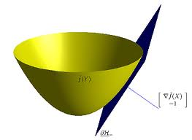
Convex functions
Convex functions look something like:
One definition: The line segment between any two points on the function is above the function

Slide 28
Surrogate loss functions
For many applications, we really would like to minimize the 0/1 loss
A surrogate loss function is a loss function that provides an upper bound on the actual loss function (in this case, 0/1)
We’d like to identify convex surrogate loss functions to make them easier to minimize
Key to a loss function is how it scores the difference between the actual label y and the predicted label y’

Slide 29
Surrogate loss functions
0/1 loss:
Ideas?
Some function that is a proxy for error, but is continuous and convex

Slide 30
Surrogate loss functions
0/1 loss:
Hinge:
Exponential:
Squared loss:
Why do these work? What do they penalize?

Slide 31
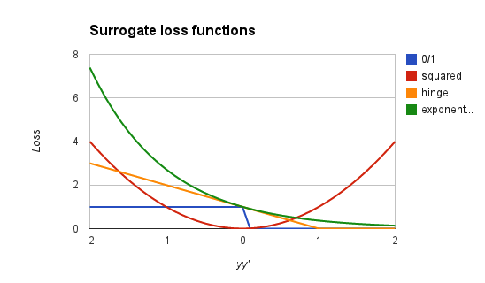
Surrogate loss functions
0/1 loss:
Hinge:
Squared loss:
Exponential:
Notes:
notice, all are convex
all (except hinge) are differentiable

Slide 32
Model-based machine learning
pick a model
pick a criteria to optimize (aka objective function)
develop a learning algorithm
use a convex surrogate loss function
Find w and b that minimize the surrogate loss

Slide 33
Finding the minimum
You’re blindfolded, but you can see out of the bottom of the blindfold to the ground right by your feet. I drop you off somewhere and tell you that you’re in a convex shaped valley and escape is at the bottom/minimum. How do you get out?

Slide 34
Finding the minimum
loss
w
How do we do this for a function?

Slide 35
One approach: gradient descent
Partial derivatives give us the slope (i.e. direction to move) in that dimension
loss
w

Slide 36
One approach: gradient descent
Partial derivatives give us the slope (i.e. direction to move) in that dimension
Approach:
pick a starting point (w)
repeat:
pick a dimension
move a small amount in that dimension towards decreasing loss (using the derivative)
loss
w

Slide 37
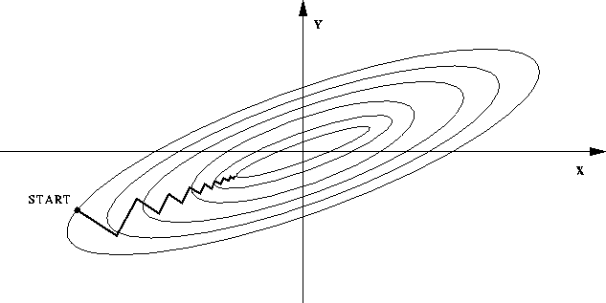
One approach: gradient descent
Partial derivatives give us the slope (i.e. direction to move) in that dimension
Approach:
pick a starting point (w)
repeat:
pick a dimension
move a small amount in that dimension towards decreasing loss (using the derivative)

Slide 38
Gradient descent
pick a starting point (w)
repeat until loss doesn’t decrease in all dimensions:
pick a dimension
move a small amount in that dimension towards decreasing loss (using the derivative)
What does this do?

Slide 39
Gradient descent
pick a starting point (w)
repeat until loss doesn’t decrease in all dimensions:
pick a dimension
move a small amount in that dimension towards decreasing loss (using the derivative)
learning rate (how much we want to move in the error direction, often this will change over time)

Slide 40
Some maths

Slide 41
Gradient descent
pick a starting point (w)
repeat until loss doesn’t decrease in all dimensions:
pick a dimension
move a small amount in that dimension towards decreasing loss (using the derivative)
What is this doing?

Slide 42
Exponential update rule
for each example x_{i}:
Does this look familiar?

Slide 43
Perceptron learning algorithm!
repeat until convergence (or for some # of iterations):
for each training example (f₁, f₂, …, f_{m}, label):
if prediction * label ≤ 0: // they don’t agree
for each w_{j}:
w_{j} = w_{j} + f_{j}*label
b = b + label
or
where

Slide 44
The constant
learning rate
label
prediction
When is this large/small?

Slide 45
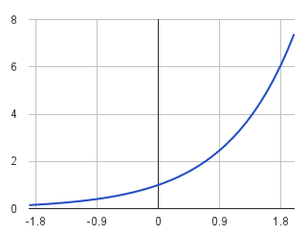
The constant
label
prediction
If they’re the same sign, as the predicted gets larger there update gets smaller
If they’re different, the more different they are, the bigger the update

Slide 46
Perceptron learning algorithm!
repeat until convergence (or for some # of iterations):
for each training example (f₁, f₂, …, f_{m}, label):
if prediction * label ≤ 0: // they don’t agree
for each w_{j}:
w_{j} = w_{j} + f_{j}*label
b = b + label
Note: for gradient descent, we always update
or
where

Slide 47
Summary
Model-based machine learning:
define a model, objective function (i.e. loss function), minimization algorithm
Gradient descent minimization algorithm
require that our loss function is convex
make small updates towards lower losses
Perceptron learning algorithm:
gradient descent
exponential loss function (modulo a learning rate)

