Slide 1
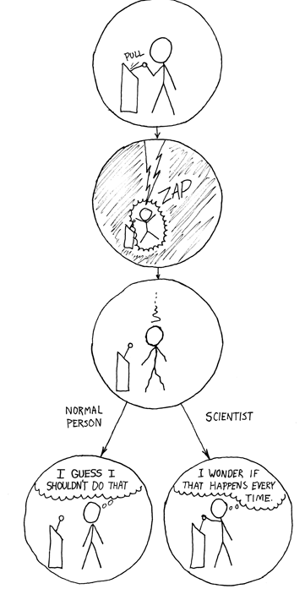
http://xkcd.com/242/

Slide 2
Text Classification 2
David Kauchak
cs459
Fall 2012
adapted from: http://www.stanford.edu/class/cs276/handouts/lecture10-textcat-naivebayes.ppt
http://www.stanford.edu/class/cs276/handouts/lecture11-vector-classify.ppt
http://www.stanford.edu/class/cs276/handouts/lecture12-SVMs.ppt

Slide 3
Administrative
Project status update
Due 11/27 (A week from today by midnight)
Take this seriously
I want to see some progress
Quiz
Mean: 20.4
Median: 19.5
Will curve the scores up some (one example, add 10 divide by 35)
Assignment 4 back soon…

Slide 4
Bias/variance trade-off
We want to fit a polynomial to this, which one should we use?

Slide 5
Bias/variance trade-off
Bias: How well does the model predict the training data?
high bias – the model doesn’t do a good job of predicting the training data (high training set error)
The model predictions are biased by the model
Variance: How sensitive to the training data is the learned model?
high variance – changing the training data can drastically change the learned model
High variance OR high bias?

Slide 6
Bias/variance trade-off
Bias: How well does the model predict the training data?
high bias – the model doesn’t do a good job of predicting the training data (high training set error)
The model predictions are biased by the model
Variance: How sensitive to the training data is the learned model?
high variance – changing the training data can drastically change the learned model
High bias

Slide 7
Bias/variance trade-off
Bias: How well does the model predict the training data?
high bias – the model doesn’t do a good job of predicting the training data (high training set error)
The model predictions are biased by the model
Variance: How sensitive to the training data is the learned model?
high variance – changing the training data can drastically change the learned model
High variance OR high bias?

Slide 8
Bias/variance trade-off
Bias: How well does the model predict the training data?
high bias – the model doesn’t do a good job of predicting the training data (high training set error)
The model predictions are biased by the model
Variance: How sensitive to the training data is the learned model?
high variance – changing the training data can drastically change the learned model
High variance

Slide 9
Bias/variance trade-off
Bias: How well does the model predict the training data?
high bias – the model doesn’t do a good job of predicting the training data (high training set error)
The model predictions are biased by the model
Variance: How sensitive to the training data is the learned model?
high variance – changing the training data can drastically change the learned model
What do we want?

Slide 10
Bias/variance trade-off
Bias: How well does the model predict the training data?
high bias – the model doesn’t do a good job of predicting the training data (high training set error)
The model predictions are biased by the model
Variance: How sensitive to the training data is the learned model?
high variance – changing the training data can drastically change the learned model
Compromise between bias and variance

Slide 11
k-NN vs. Naive Bayes
How do k-NN and NB sit on the variance/bias spectrum?
k-NN has high variance and low bias.
more complicated model
can model any boundary
but very dependent on the training data
NB has low variance and high bias.
Decision surface has to be linear
Cannot model all data
but, less variation based on the training data
Notes:
Bias/variance in terms of resulting classifier given randomly selected training set; why it is a tradeoff; when to choose low-bias method, when to choose low-variance method

Slide 12
Bias vs. variance: Choosing the correct model capacity
Which separating line should we use?

Slide 13
Separation by Hyperplanes
A strong high-bias assumption is linear separability:
in 2 dimensions, can separate classes by a line
in higher dimensions, need hyperplanes

Slide 14
Lots of linear classifiers
Many common text classifiers are linear classifiers
Naïve Bayes
Perceptron
Rocchio
Logistic regression
Support vector machines (with linear kernel)
Linear regression
Despite this similarity, noticeable performance difference
How might algorithms differ?

Slide 15
Which Hyperplane?
lots of possible solutions

Slide 16
Which Hyperplane?
lots of possible solutions

Slide 17
Which examples are important?

Slide 18
Which examples are important?

Slide 19
Which examples are important?

Slide 20
Another intuition
If you have to place a fat separator between classes, you have less choices, and so the capacity of the model has been decreased

Slide 21
Support Vector Machine (SVM)
SVMs maximize the margin around the separating hyperplane.
A.k.a. large margin classifiers
The decision function is fully specified by a subset of training samples, the support vectors.
Solving SVMs is a quadratic programming problem
Seen by many as the most successful current text classification method*
Support vectors
Maximize
margin
*but other discriminative methods often perform very similarly

Slide 22
Decision trees
Tree with internal nodes labeled by terms/features
Branches are labeled by tests on the weight that the term has
farm vs. not farm
x > 100

Slide 23
Decision trees
Roots are labeled with the class

Slide 24
Decision trees
Classifier categorizes a document by descending tree following tests to leaf
The label of the leaf node is then assigned to the document

Slide 25
Decision trees
wheat, not(farm), commodity, not(agriculture)?

Slide 26
Decision trees
not(wheat), not(farm), commodity, export, buschi?

Slide 27
Decision trees
Most decision trees are binary trees
DT make good use of a few high-leverage features
Linear or non-linear classifier?

