Slide 1
Audio Retrieval
David Kauchak
cs160
Fall 2009

Slide 2
Administrative
Assign 4 due Friday
Previous scores

Slide 3
Final project

Slide 4
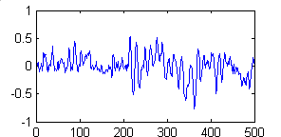
Audio retrieval
text retrieval
corpus
audio retrieval
corpus

Slide 5
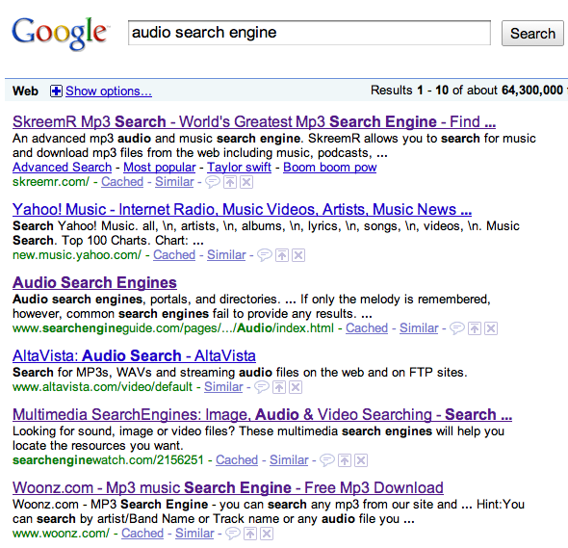
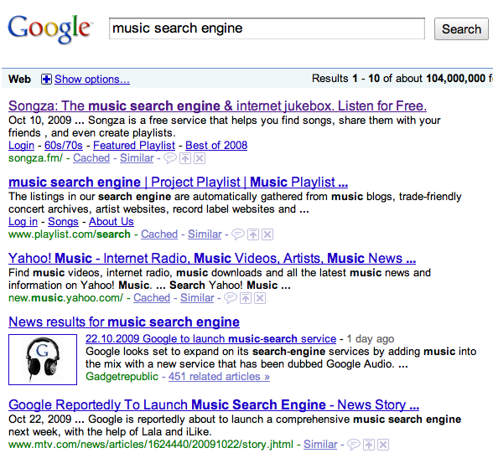
Current audio search engines

Slide 6
What do you want from an audio search engine?
Name: You might know the name of the song or the artist
Genre: You might try “Bebop,” “Latin Jazz,” or “Rock”
Instrumentation: The tenor sax, guitar, and double bass are all featured in the song
Emotion: The song has a “cool vibe” that is “upbeat“ with an “electric texture”
Some other approaches to search:
  musicovery.com
  pandora.com (song similarity)
  Genius (collaborative filtering)

Slide 7





Text Index construction
Documents to
be indexed
Friends, Romans, countrymen.
text preprocessing
friend , roman , countrymen .
indexer
friend
2
4
Inverted index
roman
1
2
countryman
13
16

Slide 8
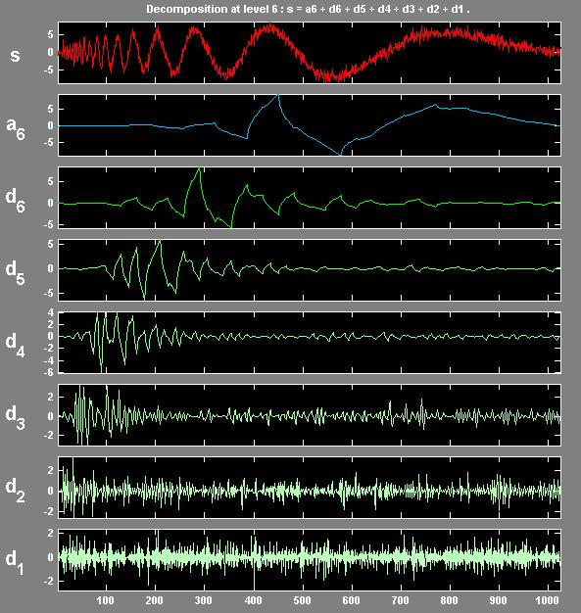
Audio Index construction
Audio files to
be indexed
wav
mp3
midi
audio preprocessing
slow,
jazzy,
punk
Today
indexer
may be keyed off of text
may be keyed off of audio features
Index

Slide 9
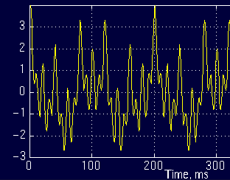
Sound
What is sound?
  A longitudinal compression wave traveling through some medium (often, air)
  Rate of the wave is the frequency
  You can think of sounds as a sum of sign waves

Slide 10
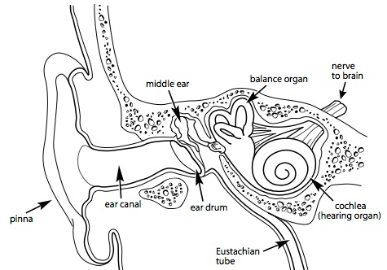
Sound
How do people hear sound?
  The cochlea in the inner ear has hair cells that "wiggle" when certain frequency are encountered
http://www.bcchildrens.ca/NR/rdonlyres/8A4BAD04-A01F-4469-8CCF-EA2B58617C98/16128/theear.jpg

Slide 11
Digital Encoding
Like everything else for computers, we must represent audio signals digitally
Encoding formats:
  WAV
  MIDI
  MP3
  Others…

Slide 12
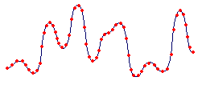
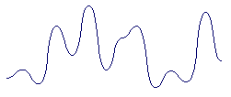
WAV
Simple encoding
Sample sound at some interval (e.g. 44 KHz).
High sound quality
Large file sizes

Slide 13
MIDI
Musical Instrument Digital Interface
MIDI is a language
Sentences describe the channel, note, loudness, etc.
16 channels (each can be thought of and recorded as a separate instrument)
Common for audio retrieval and classification applications

Slide 14
MP3
Common compression format
3-4 MB vs. 30-40 MB for uncompressed
Perceptual noise shaping
  The human ear cannot hear certain sounds
  Some sounds are heard better than others
  The louder of two sounds will be heard
Lossy or lossless?
  Lossy compression
  quality depends on the amount of compression
  like many compression algorithms, can have issues with randomness (e.g. clapping)

Slide 15
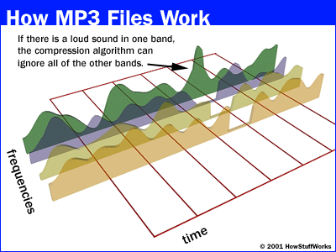
MP3 Example

Slide 16
Features
Weight vectors
word frequency
count normalization
idf weighting
length normalization
?

Slide 17
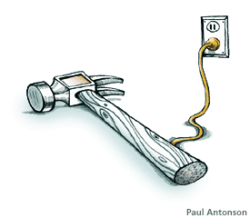
Tools for Feature Extraction
Fourier Transform (FT)
Short Term Fourier Transform (STFT)
Wavelets

Slide 18
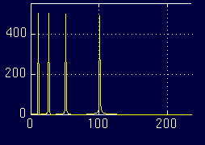
Fourier Transform (FT)
Time-domain Frequency-domain

Slide 19
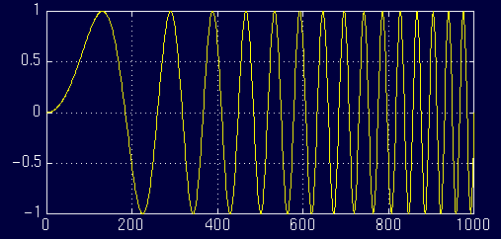
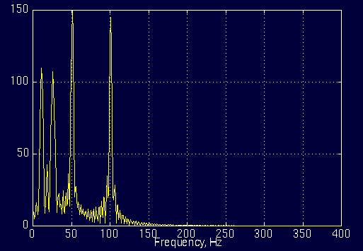
Another FT Example
Time
Frequency

Slide 20
Problem?
≈

Slide 21
Problem with FT
FT contains only frequency information
No time information is retained
Works fine for stationary signals
Non-stationary or changing signals cause problems
  FT shows frequencies occurring at all times instead of specific times
Ideas?

Slide 22
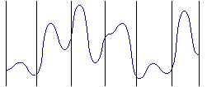
Short-Time Fourier Transform (STFT)
Idea: Break up the signal into discrete windows
Treat each signal within a window as a stationary signal
Take FT over each part
…

Slide 23
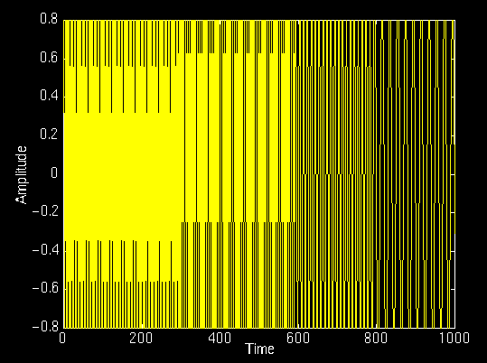
STFT Example
amplitude
time
frequency

Slide 24
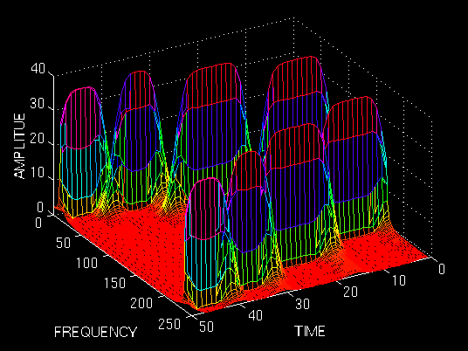
STFT Example

Slide 25
Problem: Resolution
How do we pick the window size?
We can vary time and frequency accuracy
  Narrow window: good time resolution, poor frequency resolution
  Wide window: good frequency resolution, poor time resolution

Slide 26
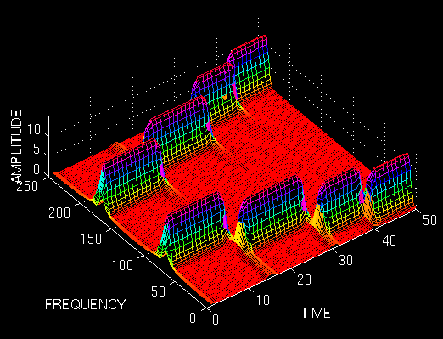
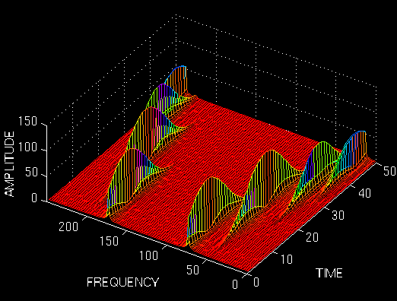
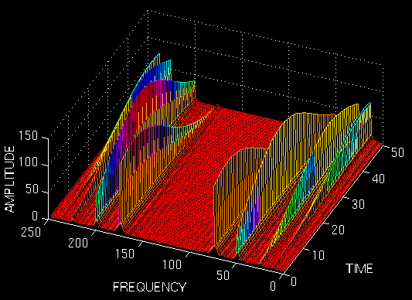
Varying the resolution
Ideas?

Slide 27
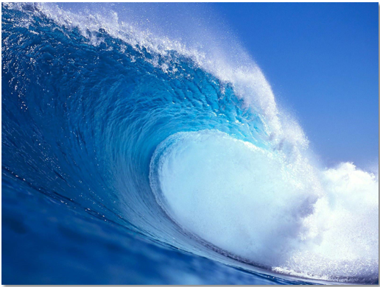
Wavelets
Wave
Wavelets
☺

Slide 28
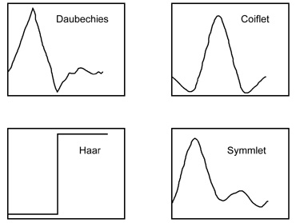
Wavelets
Wavelets respond to signals that are similar

Slide 29
Wavelet response
A wavelet responds to signals that are similar to the wavelet
?

Slide 30
Wavelet response
Scale matters!
?

Slide 31
Wavelet Transform
Idea: Take a wavelet and vary scale
Check response of varying scales on signal

Slide 32
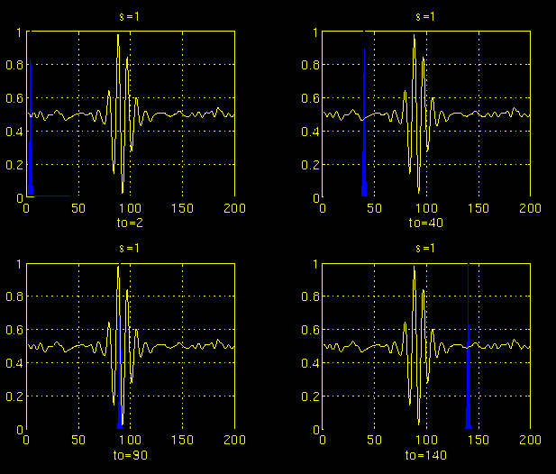
Wavelet Example: Scale 1

Slide 33
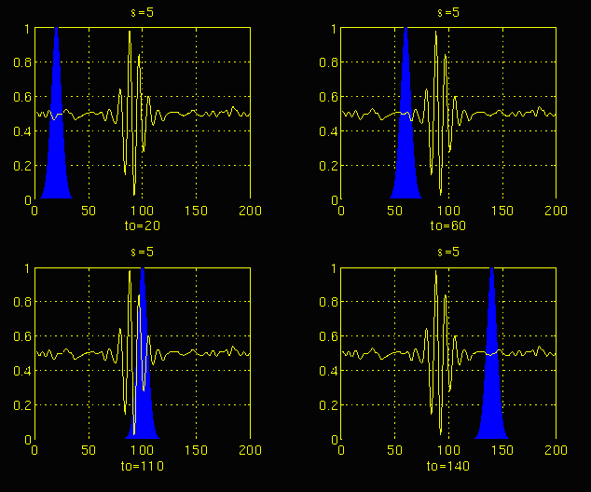
Wavelet Example: Scale 2

Slide 34
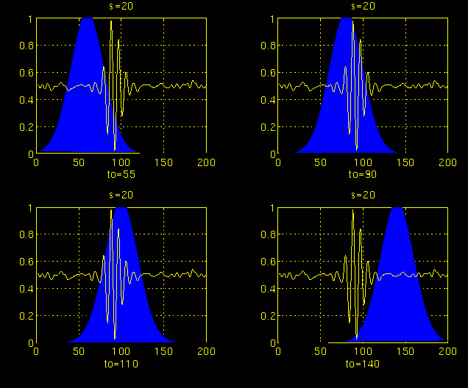
Wavelet Example: Scale 3

Slide 35
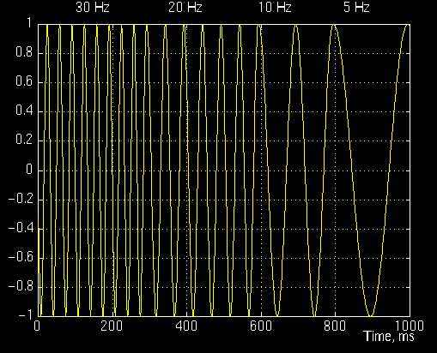
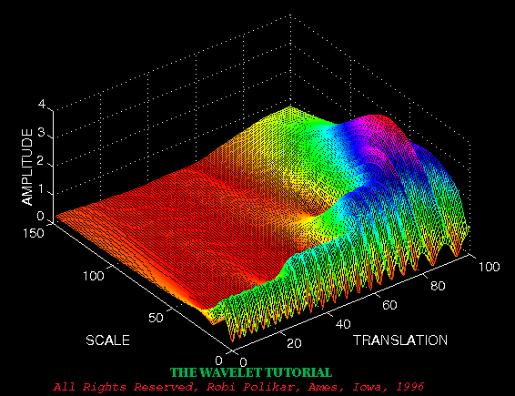
Wavelet Example
Scale = 1/frequency
Translation ≈ Time

Slide 36
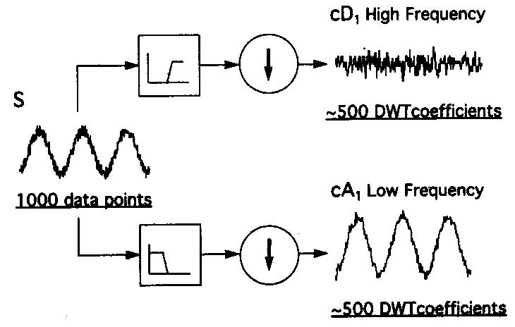
Discrete Wavelet Transform (DWT)
Wavelets come in pairs (high pass and low pass filter)
Split signal with filter and downsample

Slide 37
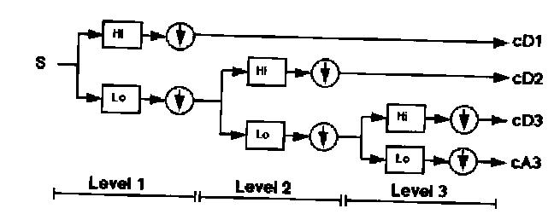
DWT cont.
Continue this process on the low frequency portion of the signal

Slide 38
DWT Example
signal
low frequency
high frequency

Slide 39
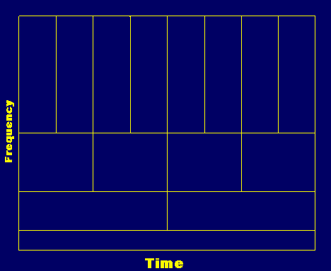
How did this solve the resolution problem?
Higher frequency resolution at high frequencies
Higher time frequency at low frequencies

Slide 40
Feature Extraction
All these transforms help us understand how the frequencies changes over time
Features extraction:
  Mel-frequency cepstral coefficients (MFCCs)
    Attempt to mimic human ear
  Surface features (texture, timbre, instrumentation)
    Capture frequency statistics of STFT
  Rhythm features (i.e the “beat”)
    Characteristics of low-frequency wavelets

Slide 41
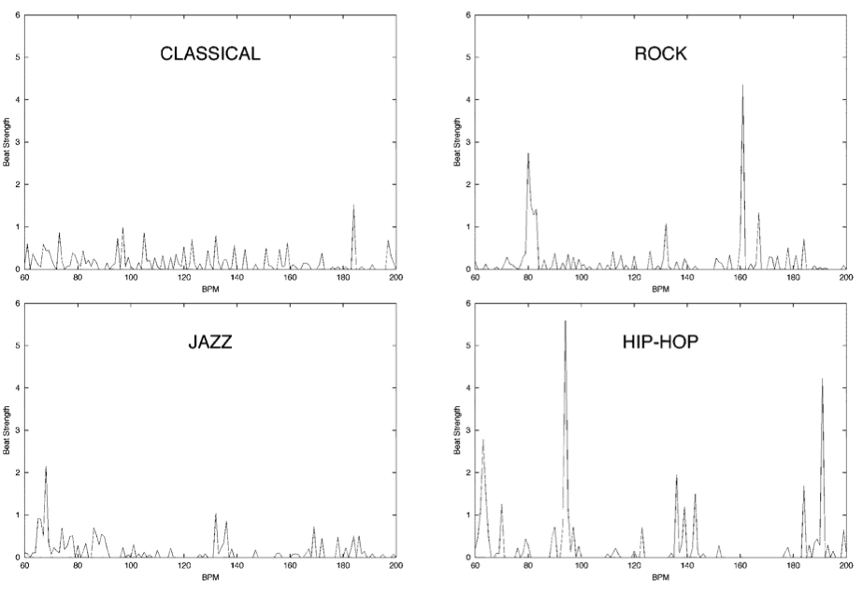

Slide 42
Music Classification
Data
  Audio collected from radio, CDs and Web
    Genres: classic, country, hiphop, jazz, rock
    Speech vs. music
    4-types of classical music
  50 samples for each class, 30 sec. long
  Task is to predict the genre of the clip
Approach
  Extract features
  Learn genre classifier

Slide 43
General Results
 | Music vs. Speech | Genres | Classical
Random | 50% | 16% | 25%
Classifier | 86% | 62% | 76%

Slide 44
Results: Musical Genres
 | Classic | Country | Disco | Hiphop | Jazz | Rock
Classic | 86 | 2 | 0 | 4 | 18 | 1
Country | 1 | 57 | 5 | 1 | 12 | 13
Disco | 0 | 6 | 55 | 4 | 0 | 5
Hiphop | 0 | 15 | 28 | 90 | 4 | 18
Jazz | 7 | 1 | 0 | 0 | 37 | 12
Rock | 6 | 19 | 11 | 0 | 27 | 48
Pseudo-confusion matrix

Slide 45
Results: Classical
 | Choral | Orchestral | Piano | String
Choral | 99 | 10 | 16 | 12
Orchestral | 0 | 53 | 2 | 5
Piano | 1 | 20 | 75 | 3
String | 0 | 17 | 7 | 80
Confusion matrix

Slide 46
Google Books

Slide 47
Thanks
Robi Polikar for his old tutorial (http://www.public.iastate.edu/~rpolikar/WAVELETS/WTtutorial.html)

Slide 48
Musical surface features
What we’d like to do:
  Represents characteristics of music
    Texture
    Pitch
    Timbre
    Instrumentation
We need to quantify these things
  Statistics that describe frequency distribution
    Average frequency
    Shape of the distribution
    Number zero Crossings
  Rhythm features

Slide 49
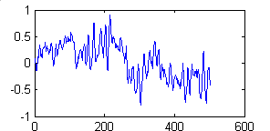
Calculating Surface Features
Divide into windows
Calculate feature for window
Calculate mean and std. dev. over windows
Signal
FFT over window
Σ…

Slide 50
Surface Features
Centroid: Measures spectral brightness
Rolloff: Spectral Shape
R such that:
M[f] = magnitude of FFT at frequency bin f over N bins

Slide 51
More surface features
Flux: Spectral change
Zero Crossings: Noise in signal
Low Energy: Percentage of windows that have energy less than average
Where, M_{p}[f] is M[f] of the previous window

Slide 52
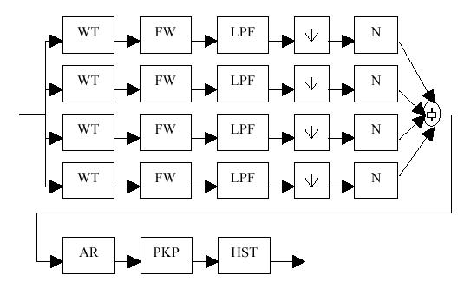
Rhythm Features
Wavelet Transform
Full Wave Rectification
Low Pass Filtering
Downsampling
Normalize

Slide 53

Rhythm Features cont.
Autocorrelation – The cross-correlation of a signal with itself (i.e. portions of a signal with it’s neighbors)
Take first 5 peaks
Histogram over windows of the signal

Slide 54
Actual Rhythm Features
Using the “beat” histogram…
  Period0 - Period in bpm of first peak
  Amplitude0 - First peak divided by sum of amplitude
  RatioPeriod1 - Ratio of periodicity of first peak to second peak
  Amplitude1- Second peak divided by sum of amplitudes
  RatioPeriod2, Amplitude2, RatioPeriod3, Amplitude3

Slide 55
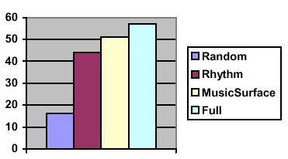
Analysis of Features

Slide 56
GUI for Audio Classification
Genre Gram
  Graphically present classification results
  Results change in real time based on confidence
  Texture mapped based on category
Genre Space
  Plots sound collections in 3-D space
  PCA to reduce dimensionality
  Rotate and interact with space

Slide 57
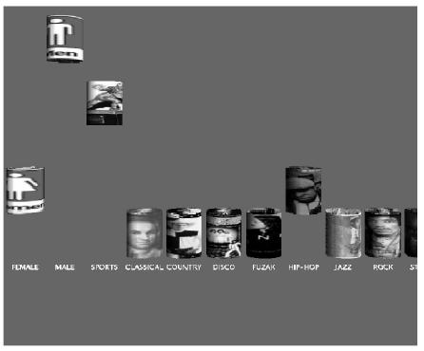
Genre Gram

Slide 58
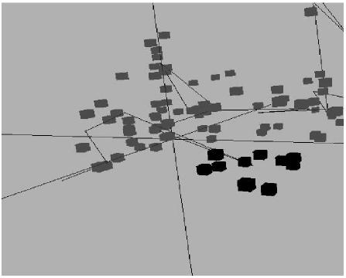
Genre Space

